Slide 1
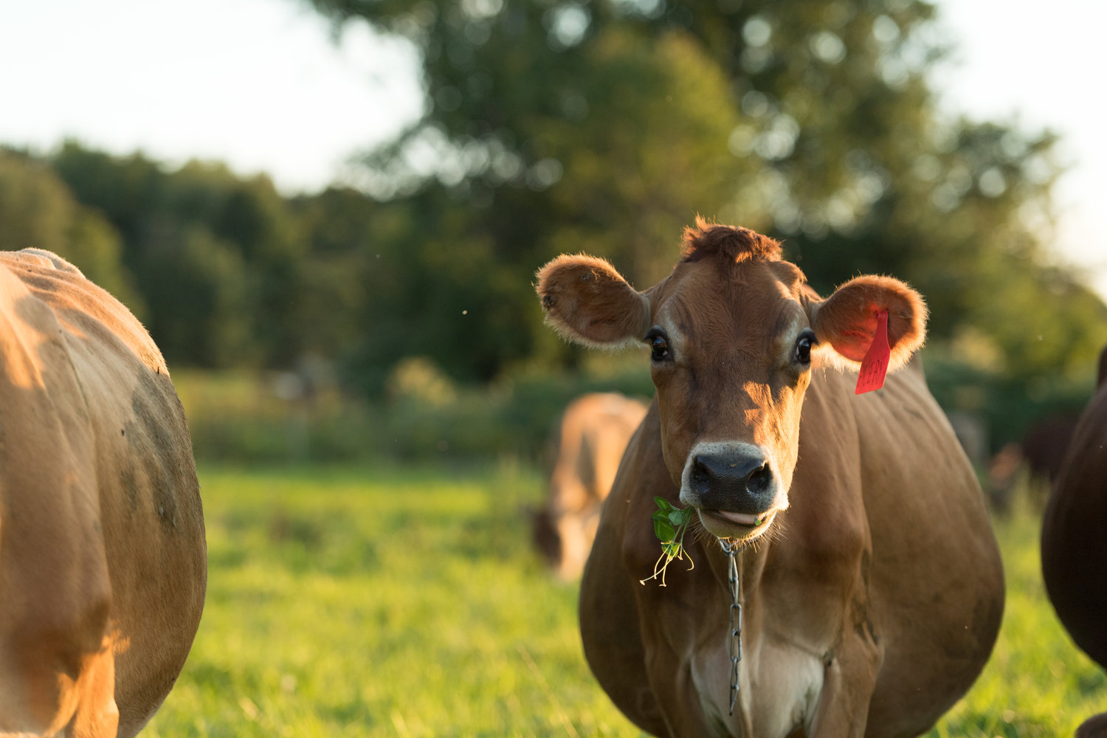
OBJECTIVE 1:
40 Herd Survey
OREI Advisory Meeting, April 6
Caitlin Jeffrey
Photo: Melanie Webb

Slide 2
OBJECTIVE 1:
Assess current bedding management practices, mastitis management, animal health and milk quality on northeastern organic dairy farms
Enroll 40 organic milk producers to collect data from in-person interviews, on-farm observations, and samples for analysis

Slide 3
Target population:
All organic dairy farms in Vermont
Exclude very small and very large herds
Source population:
Organic dairy farms in Vermont with a herd size of 35 to 120 lactating cows and test monthly through DHIA
Stratify on housing/bedding type
Initial Study sample population:
Randomly select farms from each of 4 housing type groups
Source population:
Organic dairy farms in Vermont with herd size of 35 to 120 lactating cows
Exclude herds not on monthly DHIA
OBJECTIVE 1: 40 HERD STUDY

Slide 4
40 Representative farms:
Organic dairy farms in Vermont with target herd size (35 to 120) and on DHIA (monthly)
Bedded pack (10)
Free stall: wood bedding (10)
Tie stall: wood bedding (10)
Free stall: sand bedding (10)
Sequentially enroll randomly selected herds from each non-bedded pack group until sample population identified –confirm factors such as monthly individual cow SCC testing, and winter housing variation.
Consider adding additional herds not on DHIA but willing to temporarily enroll for study
OBJECTIVE 1: 40 HERD STUDY

Slide 5
OBJECTIVE 1: Survey tool
Concerns about bedding/mastitis risk
How they may manage any chronically mastitic cows
How they identify/track mastitis
Milking facilities, procedures and udder hygiene
Dry cow management
Diet, vitamin/mineral supplementation, water source
Typical calving and periparturient practices
Fly control
OBJECTIVE 1: 40 HERD STUDY

Slide 6
OBJECTIVE 1: Survey tool
Type of housing system
Both lactating and dry
Bedding management for each housing type used
Both lactating and dry
Classification and description of any bedding material used
Both lactating and dry
Some basic herd information (production, number of lactating/dry/youngstock, breeds, record-keeping system)
OBJECTIVE 1: 40 HERD STUDY

Slide 7
OBJECTIVE 1: Survey tool: bedded packs
Bedded packs
How manage (addition materials, surface management)
Monitor moisture, temperature, density?
How is this done?
How constructed
Bedded packs vs. previously used systems
OBJECTIVE 1: 40 HERD STUDY

Slide 8
OBJECTIVE 1: Survey tool
KoBoToolbox
Free, open-source survey data software
Build customized form with variety of question types
Collect data online/offline with tablet
Analyze and manage forms online
Export to Excel
OBJECTIVE 1: 40 HERD STUDY

Slide 9
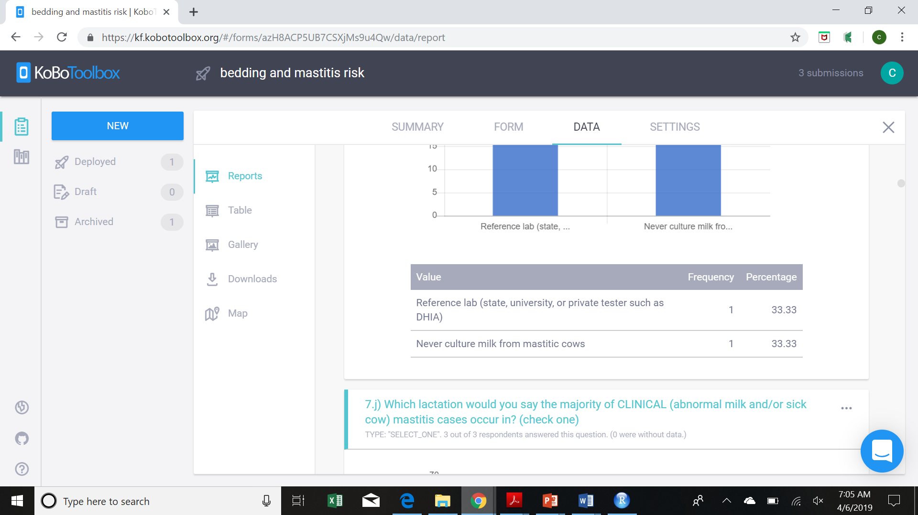
OBJECTIVE 1: Survey tool
OBJECTIVE 1: 40 HERD STUDY

Slide 10
OBJECTIVE 1: On-farm observations
Bulk tank information, cow ID, air quality
Free and tie stalls
Stall sizes, how are they cleaned
Free stalls
Pen sizes and layout, stocking density
Tie stalls
Number of stalls, trainers
Bedded pack
Size, number cows, sq. feet per cow, depth, temperature
Outdoor turn-out area
Size, stocking density, surface description
Hygiene scoring
OBJECTIVE 1: 40 HERD STUDY

Slide 11
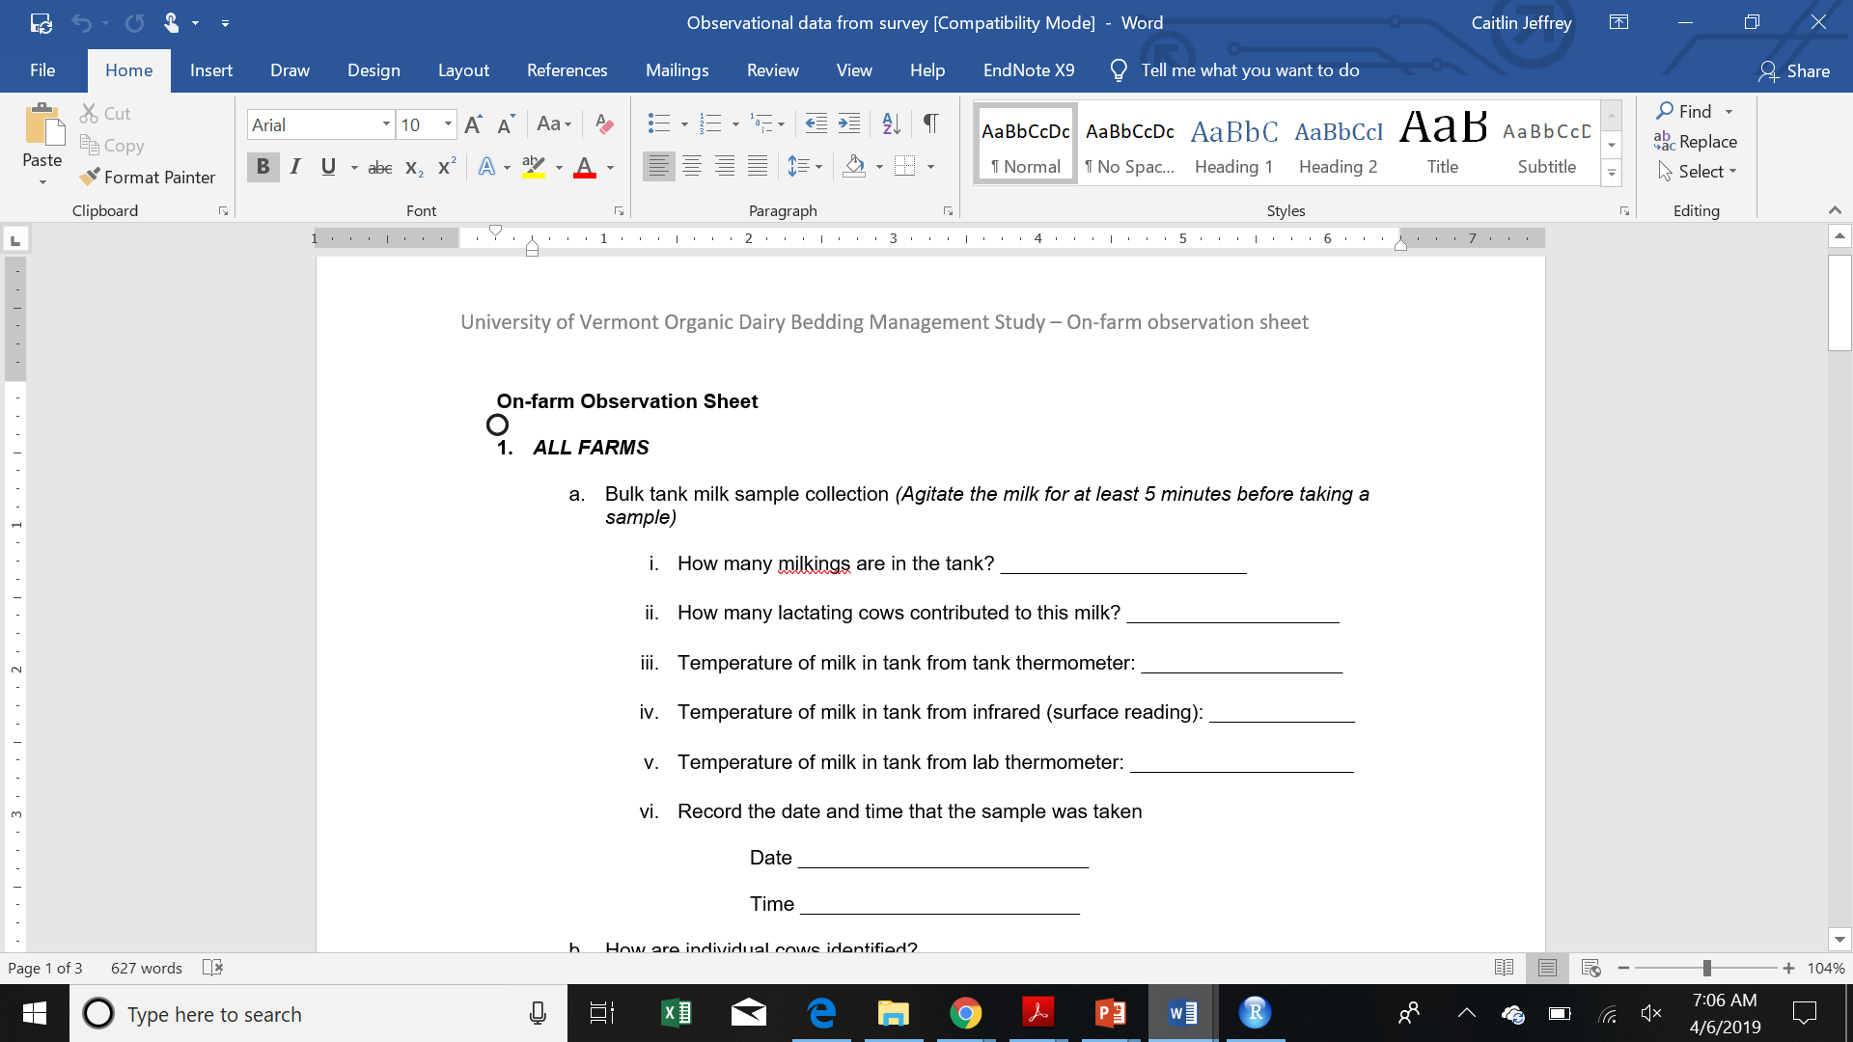
OBJECTIVE 1: On-farm observations
OBJECTIVE 1: 40 HERD STUDY

Slide 12
OBJECTIVE 1: Prospective mastitis culturing
Leaving enough materials to culture 20 cows that develop clinical mastitis over the next month
Producer to take sample, freeze, and we will collect
Pathogen identification by culture
May also be high SCC cow (identified by us or them)
OBJECTIVE 1: 40 HERD STUDY

Slide 13
Bulk tank milk
(1 x 250 mL dipper)
FRESH [2 x 35 mL] to St. Albans Coop for “Cheese-maker profile” (MUN, components, bacteriology)
FROZEN [2 x 35 mL] to U. Minnesota for aerobic culturing
FROZEN [15 mL] to UVM for: A. Collecting isolates by culture (10 mL) B. PCR for pathogens (4 mL)
FROZEN [1 mL] to U. Colorado Boulder for metagenomic analysis (bacterial and fungal sequencing)
OBJECTIVE 1: 40 HERD STUDY

Slide 14
Bedding
~ 1 gallon Ziplock
Lactating + Dry
FROZEN [2 cups] to U. Minnesota for standard aerobic bedding culture
FRESH [1 cup]/ FROZEN [1 cup] to UVM for: A. Collect isolates/inhibitors [frozen] B. % moisture analysis [fresh]
FROZEN [1 tbsp.] to U. Colorado Boulder for metagenomic analysis (bacterial and fungal sequencing)
OBJECTIVE 1: 40 HERD STUDY

Slide 15
Individual cow samples
(14 mL snap-cap tubes)
Collected by producers over 30 days after survey
FROZEN [14 mL] to UVM for collecting isolates of pathogens by culture
OBJECTIVE 1: 40 HERD STUDY

Slide 16
OBJECTIVE 1: Limitations and mitigations
Lack of producer mastitis records
DHIA
Lameness scoring
Body condition scoring
Plane of nutrition/trace mineral status
Survey tool
OBJECTIVE 1: 40 HERD STUDY

Slide 17
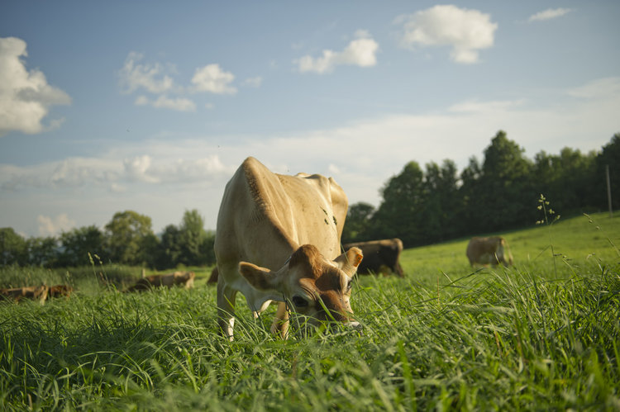
Questions, comments?
Photo: Melanie Webb

Slide 18
Bulk tank milk
1 x 250 mL dipper
FRESH [2 x 35 mL] to St. Albans Coop for “Cheese-maker profile” (MUN, components, bacteriology)
FROZEN [2 x 35 mL] to U. Minnesota for aerobic culturing
Bedding
1 gallon Ziplock
Lactating/Dry/Winter turnout
FROZEN [2 cups] to U. Minnesota for standard aerobic bedding culture
FROZEN [15 mL] to UVM for: A. Collecting isolates by culture (10 mL) B. PCR for pathogens (4 mL)
FROZEN [1 mL] to U. Colorado Boulder for metagenomic analysis (bacterial and fungal sequencing)
FRESH [1 cup]/ FROZEN [1 cup] to UVM for: A. Collect isolates/inhibitors [frozen] B. % moisture analysis [fresh]
FROZEN [1 tbsp.] to Colorado Boulder for metagenomic analysis (bacterial and fungal sequencing)
OBJECTIVE 1: 40 HERD STUDY

